Slide 1
Reversible data hiding in Encrypted Images by Reversible Image Transformation
PROJECT GUIDE:
Mrs. Shilpa Joseph
A PRESENTATION BY
Augustine Johny
Bestin Paul
Jomin V George
Robin J Augustine

Slide 2
PROBLEM STATEMENT
Vital to protect privacy of data such as images and videos

Slide 3
OBJECTIVE
To create an RIT framework.
- transfer semantics of original image (I) to that of the target image (J).
- reversibility means (I) can be losslessly restored form J.
- (J) is the same size as (I).

Slide 4
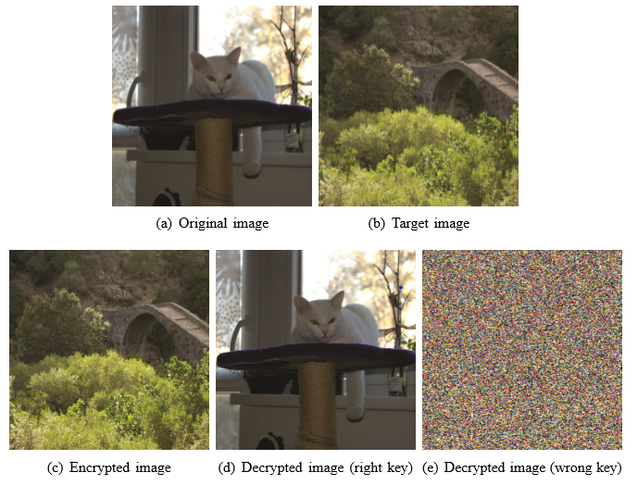
OBJECTIVE

Slide 5
LITERATURE SURVEY/ RELATED WORKS

Slide 6
Vacating room after encryption
the sender encrypts the image I into E(I) with a key K.
The cloud server embeds data by compressing the encrypted image E(I) and generates Ew(I) that is stored in the cloud.
On request, the cloud server returns E′ w(I) to the recevier, which generates I through a process of joint decompression and decryption with the key K.
the compression-based RDH method used should be speciﬁed together with the receiver.

Slide 7
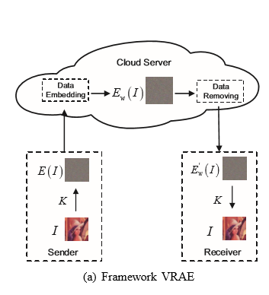

Slide 8
Reserving room before encryption
the sender reserves room from the image I and encrypts it into E(I) with a key K, and then sends it to the cloud server
Cloud server embeds data into the reserved room and generates Ew(I).
the receiver wants to retrieve the image, the cloud server can restore E(I) from Ew(I) and send E(I) to the user who can decrypt E(I) and get I with the key K.
the RDH method used should be speciﬁed with the sender, i.e, the RDH method used by cloud is sender-related.

Slide 9
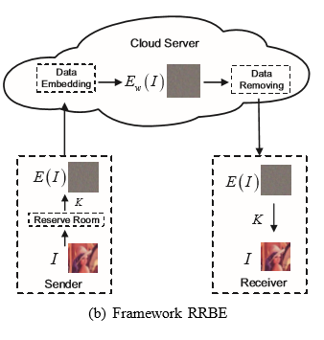

Slide 10
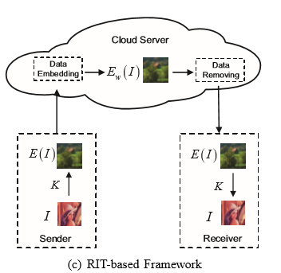
PROPOSED METHOD

Slide 11
Transformation Algorithm
Select (J) having same size as (I)
Divide both images into non-overlapping 4x4 blocks.
Pair up blocks of (I) with blocks of (J).
For each block pair (Bi,Ti) compute mean diff. & add it to each Bi and rotate the block into optimal direction θi
In (J), replace Ti with T’i and generate the transformed image J’
Encrypt the compressed sequence by standard encryption schemes such as AES with key K.
Embed accessorial information (AI) into J’ and output encrypted image E(I).

Slide 12
Anti-transformation Algorithm
Extract AI and restore the transformed image J′ from E(I).
Decrypt AI by AES scheme with the key K, and then decompress the sequence.
Divide J′ into non-overlapping N blocks with size of 4 × 4.
Rearrange the blocks of J′.
For each block T ′ i of J′ for 1 ≤ i ≤ N, rotate T ′ i in the anti-direction of θi, and then subtract mean diff. from each pixel of T ′ i, and ﬁnally output the original image I.

Slide 13
APPLICATIONS
Military Imagery
Medical Imagery
Law Forensics

Slide 14
PLATFORM
JAVA

Slide 15
REFERENCES
Z. Ni, Y. Shi, N. Ansari, and S. Wei, “Reversible data hiding,” IEEE Trans. on Circuits and Systems for Video Technology, vol. 16, no. 3, pp. 354-362, Mar. 2006.
K. Ma, W. Zhang, X. Zhao, N. Yu, F. Li, “Reversible data hiding in encrypted images by reserving room before encryption,” IEEE Trans. on Information Forensics and Security, vol. 8, no. 3, pp. 553-562, Mar. 2013.
W. Zhang, X. Hu, N. Yu, et al. “Recursive histogram modiﬁcation: establishing equivalency between reversible data hiding and lossless data compression,” IEEE Trans. on Image Processing, vol. 22, no. 7, pp. 2775-2785, Jul. 2013.

Slide 16
THANK YOU!

